Slide 1
Core Components of dynamodb
Anju munoth

Slide 2
Partitions and data distribution
Amazon DynamoDB stores data in partitions.
Partition --Allocation of storage for a table, backed by solid state drives (SSDs) and automatically replicated across multiple Availability Zones within an AWS Region.
Partition management is handled entirely by DynamoDB—never have to manage partitions yourself.
On creating a table, the initial status of the table is CREATING.
During this phase, DynamoDB allocates sufficient partitions to the table so that it can handle your provisioned throughput requirements.
Can begin writing and reading table data after the table status changes to ACTIVE.

Slide 3
Partitions and data distribution
DynamoDB allocates additional partitions to a table in the following situations:
If you increase the table's provisioned throughput settings beyond what the existing partitions can support.
If an existing partition fills to capacity and more storage space is required.
Partition management occurs automatically in the background and is transparent to your applications.
Table remains available throughout and fully supports your provisioned throughput requirements.
Global secondary indexes in DynamoDB are also composed of partitions.
The data in a global secondary index is stored separately from the data in its base table, but index partitions behave in much the same way as table partitions.

Slide 4
Data distribution: Partition key
For a table has a simple primary key (partition key only), DynamoDB stores and retrieves each item based on its partition key value.
To write an item to the table, DynamoDB uses the value of the partition key as input to an internal hash function.
Output value from the hash function determines the partition in which the item will be stored.
To read an item from the table, you must specify the partition key value for the item.
DynamoDB uses this value as input to its hash function, yielding the partition in which the item can be found.
DynamoDB is optimized for uniform distribution of items across a table's partitions, no matter how many partitions there may be.
Recommended --Choose a partition key that can have a large number of distinct values relative to the number of items in the table.

Slide 5
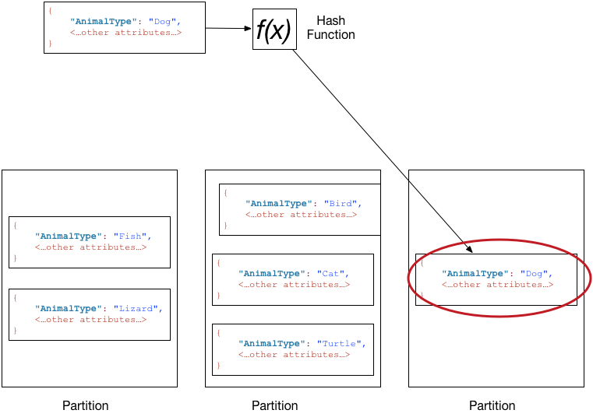
Table named Pets, which spans multiple partitions.
Primary key --AnimalType (only this key attribute is shown).
DynamoDB uses its hash function to determine where to store a new item, in this case based on the hash value of the string Dog.
Items are not stored in sorted order.
Each item's location is determined by the hash value of its partition key.

Slide 6
Data distribution: Partition key and sort key
For a table has a composite primary key (partition key and sort key), DynamoDB calculates the hash value of the partition key
Stores all the items with the same partition key value physically close together, ordered by sort key value.
To write an item to the table, DynamoDB calculates the hash value of the partition key to determine which partition should contain the item.
In that partition, several items could have the same partition key value.
So DynamoDB stores the item among the others with the same partition key, in ascending order by sort key.
To read an item from the table, you must specify its partition key value and sort key value.
DynamoDB calculates the partition key's hash value, yielding the partition in which the item can be found.

Slide 7
Data distribution: Partition key and sort key
Can read multiple items from the table in a single operation (Query) if the items you want have the same partition key value.
DynamoDB returns all of the items with that partition key value.
Optionally, can apply a condition to the sort key so that it returns only the items within a certain range of values.

Slide 8
Data distribution: Partition key and sort key
To read that same item from the Pets table, DynamoDB calculates the hash value of Dog, yielding the partition in which these items are stored.
DynamoDB then scans the sort key attribute values until it finds Fido.
To read all of the items with an AnimalType of Dog, you can issue a Query operation without specifying a sort key condition.
By default, the items are returned in the order that they are stored (that is, in ascending order by sort key).
Optionally, you can request descending order instead.
To query only some of the Dog items, you can apply a condition to the sort key (for example, only the Dog items where Name begins with a letter that is within the range A through K).

Slide 9
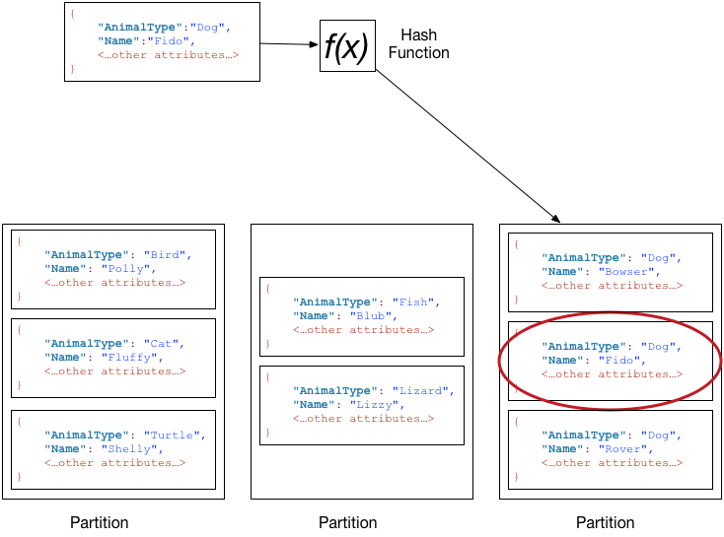
Pets table--composite primary key; AnimalType (partition key) and Name (sort key).
On writing an item with a partition key value of Dog and a sort key value of Fido.

Slide 10
Read consistency
Amazon DynamoDB is available in multiple AWS Regions around the world.
Each Region is independent and isolated from other AWS Regions.
For example, if you have a table called People in the us-east-2 Region and another table named People in the us-west-2 Region, these are considered two entirely separate tables.
Every AWS Region consists of multiple distinct locations called Availability Zones.
Each Availability Zone is isolated from failures in other Availability Zones, and provides inexpensive, low-latency network connectivity to other Availability Zones in the same Region.
This allows rapid replication of your data among multiple Availability Zones in a Region.
When your application writes data to a DynamoDB table and receives an HTTP 200 response (OK), the write has occurred and is durable. The data is eventually consistent across all storage locations, usually within one second or less.

Slide 11
Read consistency
DynamoDB supports eventually consistent and strongly consistent reads.
Eventually Consistent Reads
When you read data from a DynamoDB table, the response might not reflect the results of a recently completed write operation.
Response might include some stale data. If you repeat your read request after a short time, the response should return the latest data.
Strongly Consistent Reads
When you request a strongly consistent read, DynamoDB returns a response with the most up-to-date data, reflecting the updates from all prior write operations that were successful.
Disadvantages:
Strongly consistent reads are not supported on global secondary indexes.
Strongly consistent reads use more throughput capacity than eventually consistent reads.
If there is a network delay or outage, a strongly consistent read might not be available and DynamoDB may return a server error (HTTP 500).
If read requests do not reach the Leader node on the first attempt, then strongly consistent reads may experience a higher latency.

Slide 12
Tables, Items, and Attributes
table is a grouping of data records.
Users table -- to store data about your users, and an Orders table to store data about users' orders.
Similar to a table in a relational database or a collection in MongoDB.
item -- is a single data record in a table.
Each item in a table is uniquely identified by the stated primary key of the table.
An item is similar to a row in a relational database or a document in MongoDB.
Attributes are pieces of data attached to a single item.
Could be a simple Age attribute that stores the age of a user.
An attribute is comparable to a column in a relational database or a field in MongoDB.
Does not require attributes on items except for attributes that make up your primary key.

Slide 13
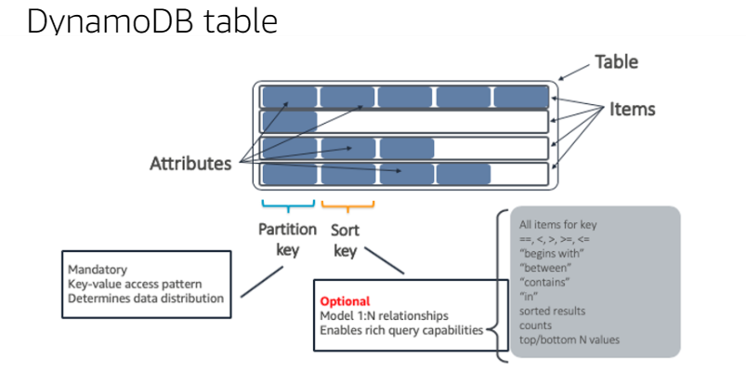

Slide 14
Attribute types
Scalar Types – A scalar type can represent exactly one value.
Scalar types are number, string, binary, Boolean, and null.
Primary keys should be scalar types.
Document Types – Represents a complex structure with nested attributes—such as you would find in a JSON document.
Document types are list and map.
Set Types – A set type can represent multiple scalar values.
Set types are string set, number set, and binary set.

Slide 15
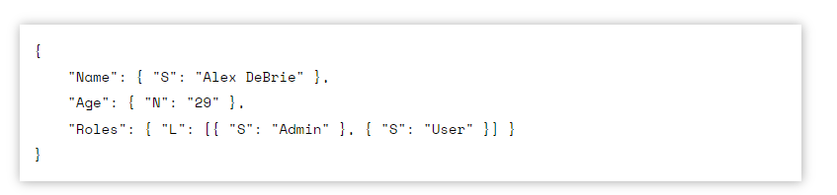
Attribute types
To store a User object with three attributes of Name, Age, and Roles, API call to store the User would look like
Stored a string attribute of "Name" with the value "Alex DeBrie" using the string indicator of "S".
Number attribute of "Age" with the value "29" with the number indicator of "N".
List attribute of "Roles" with the value containing two items, "Admin" and "User" using the list indicator of "L".

Slide 16
String type
Identifier: "S"
Example Usage:
"Name": { "S": “Roshan" }
The string type is the most basic data type, representing a Unicode string with UTF-8 encoding.
DynamoDB allows sorting and comparisons of string types according to the UTF-8 encoding.
Can be helpful when sorting last names ("Give me all last names, sorted alphabetically") or when filtering ISO timestamps ("Give me all orders between "2017-07-01" and "2018-01-01").

Slide 17
Number type
Identifier: "N"
Example Usage:
"Age": { "N": "29" }
Number type represents positive and negative numbers, or zero. It can be used for precision up to 38 digits.
Note:Send number up as a string value.
May do numerical operations on your number attributes when working with condition expressions.

Slide 18
Binary type
Identifier: "B"
Example Usage:
"SecretMessage": { "B": "bXkgc3VwZXIgc2VjcmV0IHRleHQh" }
Can use DynamoDB to store Binary data directly, such as an image or compressed data.
Generally, larger binary blobs should be stored in something like Amazon S3 rather than DynamoDB to enable greater throughput, but you may use DynamoDB if you like.
Must base64 encode the data before sending to DynamoDB.

Slide 19
Boolean type
Identifier: "BOOL"
Example Usage:
"IsActive": { "BOOL": "false" }
Boolean type stores either "true" or "false".

Slide 20
Null type
Identifier: "NULL"
Example Usage:
"OrderId": { "NULL": "true" }
Null type stores a boolean value of either "true" or "false".

Slide 21
List type
Identifier: "L"
Example Usage:
"Roles": { "L": [ "Admin", "User" ] }
List type --Store a collection of values in a single attribute.
Values are ordered and do not have to be of the same type
Can operate directly on list elements using expressions

Slide 22
Map type
Identifier: "M“
Store a collection of values in a single attribute.
For a Map attribute, these values are stored in key-value pairs, similar to the map or dictionary objects in most programming languages.
Can operate directly on map elements using expressions.

Slide 23
Map type
"FamilyMembers": {
"M": {
"Bill Murray": {
"Relationship": "Spouse",
"Age": 65
},
"Tina Turner": {
"Relationship": "Daughter",
"Age": 78,
"Occupation": "Singer"
}
}
}

Slide 24
String Set type
Identifier: "SS"
Example Usage:
"Roles": { "SS": [ "Admin", "User" ] }
Maintain a collection of unique items of the same type.
String Set is used to hold a set of strings.
Does not allow duplicates
Sets can be particularly useful with expressions.
Can run update commands to add & remove elements to a set without fetching & inserting the whole object.
May also check for the existence of an element within a set when updating or retrieving items.

Slide 25
Number Set type
Identifier: "NS"
Example Usage:
"RelatedUsers": { "NS": [ "123", "456", "789" ] }
Collection of unique items of the same type.
Used to hold a set of numbers.

Slide 26
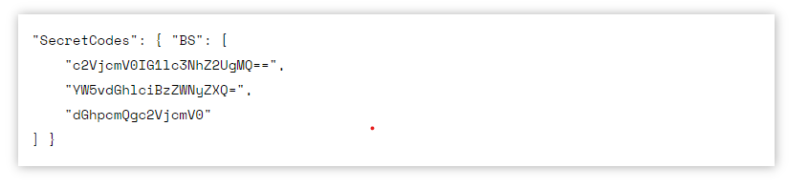
Binary Set type
Identifier: "BS“
Binary Set is used to hold a set of binary values.

Slide 27
Primary Key
Each item in a table is uniquely identified by a primary key.
Definition must be defined at the creation of the table
Must be provided when inserting a new item.
Can only have one item with a particular combination of partition key and sort key.
Two types of primary key:
simple primary key made up of just a partition key
composite primary key made up of a partition key and a sort key.

Slide 28
Primary Key
Simple Primary Key
Uses a single attribute to identify an item, such as a Username or an OrderId.
Composite Primary Key
Example would be a Users table with a Username primary key.
Sort key is used to sort items within the same partition
Example could be an Orders tables for recording customer orders on an e-commerce site.
Partition key would be the CustomerId, and the sort key would be the OrderId.
Using a DynamoDB table with a simple primary key is similar to using most simple key-value stores, such as Memcached.
uses a combination of two attributes to identify a particular item.
First attribute is a partition key (also known as a "hash key")--used to segment and distribute items across shards.
Second attribute is a sort key (also known as a "range key") --used to order items with the same partition key
table with a composite primary key can use interesting query patterns beyond simple get / set operations.

Slide 29
Composite primary key
Creating a table with a composite primary key is similar to creating a table with a simple primary key.
Define the attributes and key schema when creating the table.
Need to define two attributes rather than one. You then have to specify which attribute is HASH key and which is RANGE key.
HASH key -- how your data is partitioned
RANGE key --how that data is sorted within a particular HASH key.
HASH key is important -- can only grab data for a single HASH key in a Query operation.
HASH and RANGE keys allow for a one-to-many like structure -- for a single HASH key, there can be multiple RANGE keys.

Slide 30
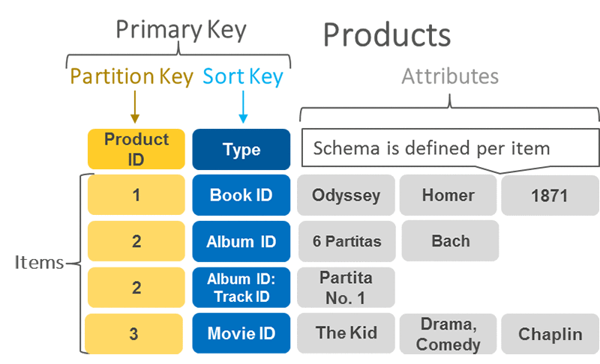

Slide 31
To create the UserOrdersTable with composite primary key using the CreateTable API call:
$ aws dynamodb create-table \
--table-name UserOrdersTable \
--attribute-definitions '[
{
"AttributeName": "Username", "AttributeType": "S"
},
{
"AttributeName": "OrderId", "AttributeType": "S"
}
]' \
--key-schema '[
{
"AttributeName": "Username", "KeyType": "HASH"
},
{
"AttributeName": "OrderId", "KeyType": "RANGE"
}
]' \
--provisioned-throughput '{
"ReadCapacityUnits": 1, "WriteCapacityUnits": 1
}' \
$LOCAL

Slide 32
And the response of create table with composite PK shows table description:
{
"TableDescription": {
"TableArn": "arn:aws:dynamodb:ddblocal:000000000000:table/UserOrdersTable",
"AttributeDefinitions": [
{ "AttributeName": "Username", "AttributeType": "S" },
{ "AttributeName": "OrderId", "AttributeType": "S" }
],
"ProvisionedThroughput": {
"NumberOfDecreasesToday": 0,
"WriteCapacityUnits": 1,
"LastIncreaseDateTime": 0.0,
"ReadCapacityUnits": 1,
"LastDecreaseDateTime": 0.0
},
"TableSizeBytes": 0,
"TableName": "UserOrdersTable",
"TableStatus": "ACTIVE",
"KeySchema": [
{ "KeyType": "HASH", "AttributeName": "Username" },
{ "KeyType": "RANGE", "AttributeName": "OrderId" }
],
"ItemCount": 0, "CreationDateTime": 1514657981.297 }}

Slide 33
Secondary Indexes
Primary key uniquely identifies an item in a table, and you may make queries against the table using the primary key.
May have additional access patterns that would be inefficient with primary key.
DynamoDB uses secondary indexes to enable these additional access patterns.

Slide 34
Secondary Indexes
Local secondary index
Uses the same partition key as the underlying table but a different sort key.
Global secondary index
Can define an entirely different primary key for a table.
To quickly access a customer's orders in descending order of the amount they spent on the order --could add a local secondary index with a partition key of CustomerId and a sort key of Amount, allowing for efficient queries on a customer's orders by amount.
Using completely different attributes to populate a partition key and sort key.
With the Order example -- could have a global secondary index with a partition key of OrderId
Could retrieve a particular order without knowing the CustomerId that placed the order.

Slide 35
Secondary Indexes
No uniqueness requirement. Recall that for a table's primary key, every item is uniquely identified by its primary key. Can't have two Items with the same key in a table.
This requirement is not applicable to secondary indexes. May have Items in your secondary index with the exact same key structure.
Secondary index attributes aren't required. When writing an Item, must specify the primary key elements.
Isn't true with secondary indexes -- may write an Item that doesn't include the attributes for secondary indexes.
If you do this, the Item won't be written to the secondary index. This is known as a sparse index and can be a very useful pattern.
Index limits per table. May create 20 global secondary indexes and 5 local secondary indexes per table.

Slide 36
Projected Attributes
When provisioning a secondary index, can specify which attributes to project into the index.
States which attributes will be available from the index directly without needing to make an additional call to the underlying table to retrieve attributes.
Options for attribute projections are:
KEYS_ONLY: Index will include only the keys for the index and the table's underlying partition and sort key values, but no other attributes.
ALL: Full Item is available in the secondary index with all attributes.
INCLUDE: May choose to name certain attributes that are projected into the secondary index.
Consider the query patterns carefully when choosing the projections.
DynamoDB charges based on the amount of data indexed, so projecting all of your attributes may result in excess charges.
On the other hand, you want to avoid making two queries to answer a question -- one to query an index for relevant keys, and a second to retrieve the needed attributes on a table for the matching keys.

Slide 37
Local Secondary Indexes
Must be specified at table creation --Cannot add a local secondary index to an existing table.
10GB limit per HASH key -- For a given HASH key, may only store 10GB of data.
Includes the size of the items in the base table plus the combined size of the items in all local secondary indexes.
This is a tricky one and is a good reason for being judicious with your projected attributes.
Consistency options. May choose between strong consistency and eventual consistency, just like on the underlying table.
Strong consistency will consume more read capacity but can be the right choice in some situations.
Shares throughput with underlying table. All local secondary indexes use the read and write capacity units of the underlying table.
Can only be used on a table with a composite primary key

Slide 38
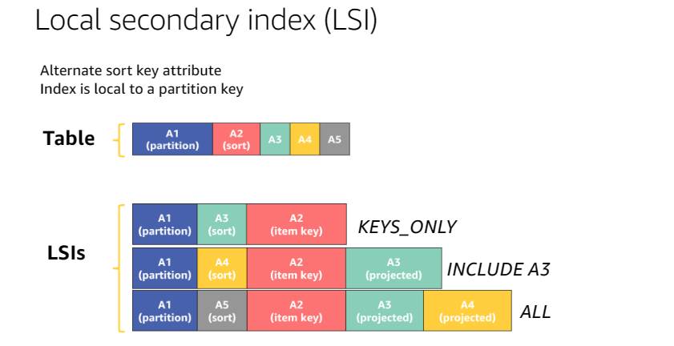

Slide 39
Creating a Local Secondary Index
--local-secondary-indexes '[
{
"IndexName": "UserAmountIndex",
"KeySchema": [
{ "AttributeName": "Username", "KeyType": "HASH“ },
{ "AttributeName": "Amount", "KeyType": "RANGE" }
],
"Projection": {
"ProjectionType": "KEYS_ONLY"
} } ]' \

Slide 40
Querying a Local Secondary Index
aws dynamodb query \
--table-name UserOrdersTable \
--index-name UserAmountIndex \
--key-condition-expression "Username = :username AND Amount > :amount" \
--expression-attribute-values '{
":username": { "S": "daffyduck" },
":amount": { "N": "100" }
}' \
$LOCAL

Slide 41
Global Secondary Indexes
Can add global secondary indexes to tables with either simple primary keys or composite primary keys.
Not limited to creating a composite key schema for the GSI index -- can create a simple key schema.
May specify a global secondary index when you initially create a table.
May also add a global secondary index after a table is already created.
DynamoDB will backfill the global secondary index based on the existing data in the table.
GSI index may be sparse
Sparse index is when not every Item contains the attribute you're indexing.
Only Items with the attribute(s) matching the key schema for the index will be copied into the index, so may end up with fewer Items in the index than in the underlying table.

Slide 42
Global Secondary Indexes
Separate throughput -- Provision read and write capacity units for a global secondary index separate than those units for the underlying table.
May add complexity and cost but also gives you flexibility to tailor the capacity to different workloads.
Eventual consistency --When writing an Item to a table, it is asynchronously replicated to global secondary indexes.
May get different results when querying a table and a global secondary index at the same time.
Do not have the ability to specify strong consistency.
No partition key size limits -- Partition keys are limited to 10GB between the table Items and all local secondary indexes.
Global secondary indexes are not counted in these limits.
Use on any table. Local secondary indexes may only be used on tables with composite primary keys.
Global secondary indexes do not have this restriction -- Can use them on tables with simple or composite primary keys.
Use with any key schema. When specifying the key schema for GSI, Can use either a simple or a composite key schema.

Slide 43
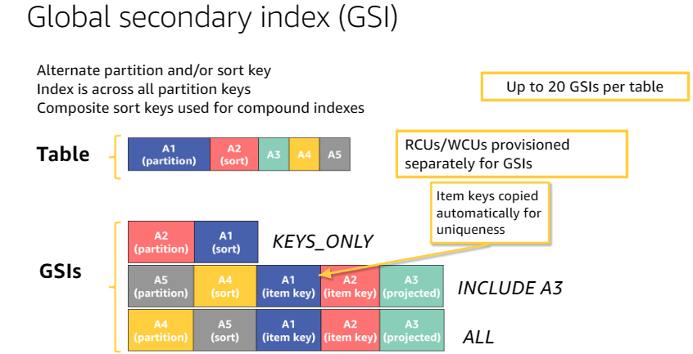

Slide 44
Creating Global Secondary Indexes
aws dynamodb update-table \
--table-name UserOrdersTable \
--attribute-definitions '[
{ "AttributeName": "ReturnDate", "AttributeType": "S" },
{ "AttributeName": "OrderId", "AttributeType": "S" }
]' \
--global-secondary-index-updates '[
{
"Create": {
"IndexName": "ReturnDateOrderIdIndex",
"KeySchema": [
{ "AttributeName": "ReturnDate", "KeyType": "HASH" },
{ "AttributeName": "OrderId", "KeyType": "RANGE" }
],
"Projection": {
"ProjectionType": "ALL"
},
"ProvisionedThroughput": { "ReadCapacityUnits": 1, "WriteCapacityUnits": 1 }
}
}
]' \
$LOCAL

Slide 45
Querying a Global Secondary Index
aws dynamodb scan \
--table-name UserOrdersTable \
--index-name ReturnDateOrderIdIndex \
$LOCAL

Slide 46
Local or global: Secondary Indexes
Two features of local secondary indexes that you can't get with global secondary indexes.
Strongly-consistent reads
Reuse of base table capacity

Slide 47
Strongly-consistent reads
When reading from the base table in DynamoDB, can choose between strongly consistent reads and eventually consistent reads.
A strongly consistent read will return the latest value for a given item, incorporating all successful write operations that have occurred.
An eventually consistent read will likely include the latest value for a given item but may reflect slightly stale data.
By default, all reads will be eventually consistent.
An eventually consistent read consumes half the read capacity units of a strongly consistent read.
For a strongly consistent read, need to include the ConsistentRead property in the API request.
A local secondary index has the same options as with a base table.
By default, all reads from a local secondary index are eventually consistent.
However, May opt into a strongly consistent read if needed
All reads from a global secondary index are eventually consistent.
For strong consistency requirements in the application, LSI is a better choice

Slide 48
Reuse of base table capacity
LSI --Reuse the provisioned throughput from the base table.
In certain situations, can be cheaper than global secondary
In Provisioned pricing mode for DynamoDB --provision a certain number of read and write capacity units for the DynamoDB table.
Specifies the maximum number of read and write operations per second that your table can handle.
With GSI --need to specify additional read and write capacity units for that index separately from your main table.
With LSI -- Use the capacity from your base table.
Need to figure the capacity needed for the main table and the capacity needed for the local secondary index. Add them together, and this is the number needed for the base table's provisioned throughput.
Shared capacity units could be helpful –during uneven workload across time such that sharing units could reduce the overall capacity units you need.

Slide 49
Reuse of base table capacity
If the read patterns on the base table and secondary index are temporally different.
Perhaps the base table is read a lot in the morning and afternoon, while the LSI is read a lot overnight when runnning reports – No need to provision capacity units on two separate entities that both account for their respective high water marks. Could share across them.
Multiple sparse local secondary indexes -- Generally, a write to your table with a local secondary index will cost 2X what it would cost for just the base table, as any write will be replicated to the index as well. However, if you had three sparse indexes on your table, and any write to your base table was only replicated to a single local secondary index, you could get efficiencies by sharing the capacity units across the multiple indexes.

Slide 50
Downsides of local secondary indexes
Must use the same partition key as the base table
Must be created when the table is created.
If the table already exists and want to add an additional secondary index to enable more access patterns, must use a global secondary index.
Adds a 10GB limit to any single item collection
An item collection is all of the items with the same partition key in the base table and local secondary indexes.

Slide 51
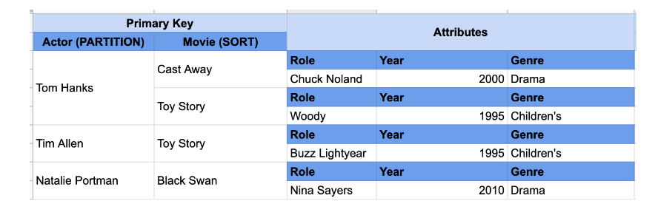
Example: Below is a table containing actors and actresses and the various movies in which they've appeared.
Might have an access pattern where you want to fetch all movies for a particular actor in a way where you can filter based on the name of the movie. Base table would look as follows

Slide 52
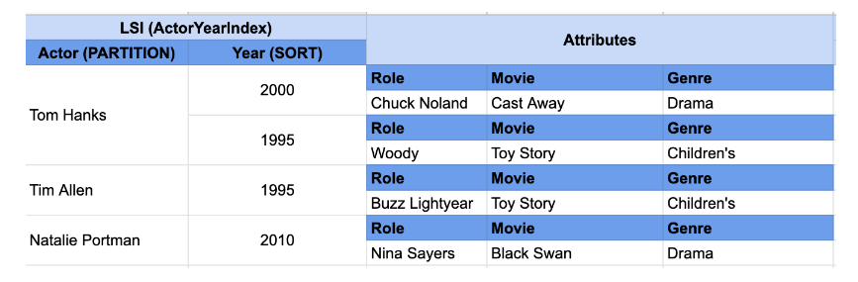
Might have a second access pattern that wants to find all movies for an actor within a given time range.
Could set up a local secondary index where the partition key is Actor and the sort key is Year.
This is the same data, it has just been rearranged due to a secondary indexes. In this example, the partition key is the same for our base table and index -- the actor's name.

Slide 53
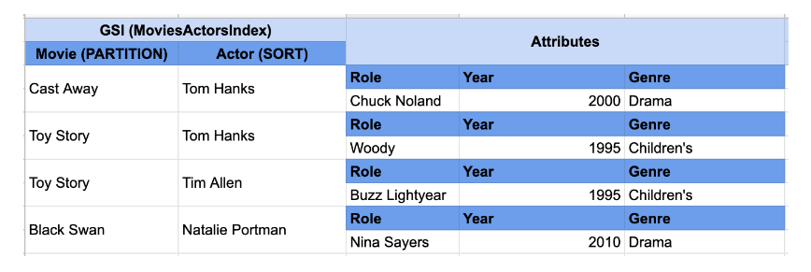
If you had a third access pattern where you wanted to find all the actors in a particular movie, a local secondary index wouldn't work. In this secondary index, you'd need to make Movie your partition key and Actor your sort key.
Because the partition key is different than your base table, you couldn't use a local secondary index.

Slide 54
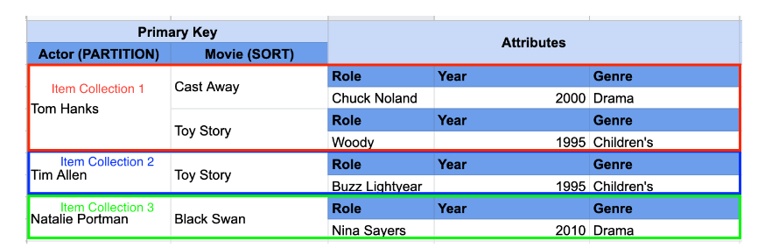
Local secondary indexes add an item collection size limit
In a single actor's partition, would need to add up the total size of the items to get the size of the item collection.
Using a LSI, the item collection includes the size of all items with that partition key in the local secondary index as well.
If you're projecting the full item into your index, this would double the size of your item collection.
Won't be a problem for most applications if you have a partition key with high cardinality to distribute values across your key space.
But what if you had an actor that's been in a lot of movies?

Slide 55
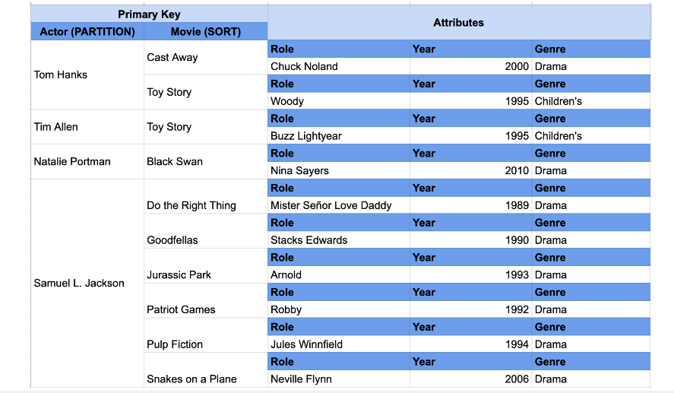
Samuel L. Jackson has been in a lot of movies. Might hit the item collection limit. Would block reads on your base table if you would exceed the 10GB limit, which would be a frightening surprise.
Note that the 10GB item collection size limit does not apply at all if there is no LSI on the table

Slide 56
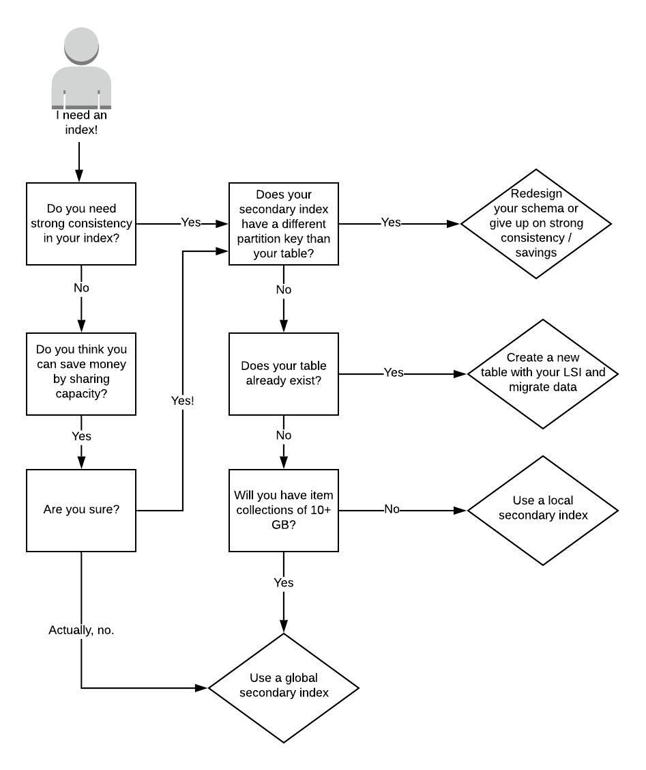

Slide 57
Table class
DynamoDB offers two table classes designed to help you optimize for cost.
DynamoDB Standard table class is the default, and is recommended for the vast majority of workloads.
DynamoDB Standard-Infrequent Access (DynamoDB Standard-IA) table class is optimized for tables where storage is the dominant cost.
For example, tables that store infrequently accessed data, such as application logs, old social media posts, e-commerce order history, and past gaming achievements, are good candidates for the Standard-IA table class.

Slide 58
Table class
Every DynamoDB table is associated with a table class.
All secondary indexes associated with the table use the same table class.
Can set your table class when creating your table (DynamoDB Standard by default) and update the table class of an existing table using the AWS Management Console, AWS CLI, or AWS SDK.
Each table class offers different pricing for data storage as well as read and write requests.

Slide 59
Choosing a table class
The DynamoDB Standard table class offers lower throughput costs than DynamoDB Standard-IA and is the most cost-effective option for tables where throughput is the dominant cost.
Standard-IA table class offers lower storage costs than DynamoDB Standard, and is the most cost-effective option for tables where storage is the dominant cost.
When storage exceeds 50% of the throughput (reads and writes) cost of a table using the DynamoDB Standard table class, the DynamoDB Standard-IA table class can help you reduce your total table cost.
DynamoDB Standard-IA tables offer the same performance, durability, and availability as DynamoDB Standard tables.
Switching between the DynamoDB Standard and DynamoDB Standard-IA table classes does not require changing your application code.
Can use the same DynamoDB APIs and service endpoints regardless of the table class your tables use.
DynamoDB Standard-IA tables are compatible with all existing DynamoDB features such as auto scaling, on-demand mode, time-to-live (TTL), on-demand backups, point-in-time recovery (PITR), and global secondary indexes.

Slide 60
Capacity units
—the amount of data your application needs to read or write per second

Slide 61
Read capacity units (RCU)
A read capacity unit represents one strongly consistent read per second, or two eventually consistent reads per second, for an item up to 4 KB in size.
For example, suppose that you create a table with 10 provisioned read capacity units. This allows you to perform 10 strongly consistent reads per second, or 20 eventually consistent reads per second, for items up to 4 KB.
Reading an item larger than 4 KB consumes more read capacity units.
For example, a strongly consistent read of an item that is 8 KB (4 KB × 2) consumes 2 read capacity units.
An eventually consistent read on that same item consumes only 1 read capacity unit.
Item sizes for reads are rounded up to the next 4 KB multiple. For example, reading a 3,500-byte item consumes the same throughput as reading a 4 KB item.

Slide 62
Capacity unit consumption for reads
GetItem—Reads a single item from a table.
To determine the number of capacity units that GetItem will consume, take the item size and round it up to the next 4 KB boundary.
If you specified a strongly consistent read, this is the number of capacity units required.
For an eventually consistent read (the default), divide this number by two.
For example, if you read an item that is 3.5 KB, DynamoDB rounds the item size to 4 KB. If you read an item of 10 KB, DynamoDB rounds the item size to 12 KB.

Slide 63
Capacity unit consumption for reads
BatchGetItem—Reads up to 100 items, from one or more tables.
DynamoDB processes each item in the batch as an individual GetItem request, so DynamoDB first rounds up the size of each item to the next 4 KB boundary, and then calculates the total size.
The result is not necessarily the same as the total size of all the items.
For example, if BatchGetItem reads a 1.5 KB item and a 6.5 KB item, DynamoDB calculates the size as 12 KB (4 KB + 8 KB), not 8 KB (1.5 KB + 6.5 KB).

Slide 64
Capacity unit consumption for reads
Query—Reads multiple items that have the same partition key value.
All items returned are treated as a single read operation, where DynamoDB computes the total size of all items and then rounds up to the next 4 KB boundary.
For example, suppose your query returns 10 items whose combined size is 40.8 KB.
DynamoDB rounds the item size for the operation to 44 KB.
If a query returns 1500 items of 64 bytes each, the cumulative size is 96 KB.
Scan—Reads all items in a table.
DynamoDB considers the size of the items that are evaluated, not the size of the items returned by the scan.

Slide 65
Capacity unit consumption for reads
For a read operation on an item that does not exist, DynamoDB still consumes provisioned read throughput: A strongly consistent read request consumes one read capacity unit, while an eventually consistent read request consumes 0.5 of a read capacity unit.
For any operation that returns items, you can request a subset of attributes to retrieve.
However, doing so has no impact on the item size calculations.
Query and Scan can return item counts instead of attribute values.
Getting the count of items uses the same quantity of read capacity units and is subject to the same item size calculations.
This is because DynamoDB has to read each item in order to increment the count.

Slide 66
Write capacity units
A write capacity unit represents one write per second, for an item up to 1 KB in size.
For example, suppose that you create a table with 10 write capacity units.
Can perform 10 writes per second, for items up to 1 KB in size per second.
Item sizes for writes are rounded up to the next 1 KB multiple.
For example, writing a 500-byte item consumes the same throughput as writing a 1 KB item.

Slide 67
Capacity unit consumption for writes
PutItem—Writes a single item to a table.
If an item with the same primary key exists in the table, the operation replaces the item.
For calculating provisioned throughput consumption, the item size that matters is the larger of the two.

Slide 68
Capacity unit consumption for writes
UpdateItem—Modifies a single item in the table.
DynamoDB considers the size of the item as it appears before and after the update.
The provisioned throughput consumed reflects the larger of these item sizes.
Even if you update just a subset of the item's attributes, UpdateItem will still consume the full amount of provisioned throughput (the larger of the "before" and "after" item sizes).
DeleteItem—Removes a single item from a table.
The provisioned throughput consumption is based on the size of the deleted item.

Slide 69
Capacity unit consumption for writes
BatchWriteItem—Writes up to 25 items to one or more tables.
DynamoDB processes each item in the batch as an individual PutItem or DeleteItem request (updates are not supported).
So DynamoDB first rounds up the size of each item to the next 1 KB boundary, and then calculates the total size.
The result is not necessarily the same as the total size of all the items.
For example, if BatchWriteItem writes a 500-byte item and a 3.5 KB item, DynamoDB calculates the size as 5 KB (1 KB + 4 KB), not 4 KB (500 bytes + 3.5 KB).

Slide 70
Capacity unit consumption for writes
For PutItem, UpdateItem, and DeleteItem operations, DynamoDB rounds the item size up to the next 1 KB.
For example, if you put or delete an item of 1.6 KB, DynamoDB rounds the item size up to 2 KB.
PutItem, UpdateItem, and DeleteItem allow conditional writes, where you specify an expression that must evaluate to true in order for the operation to succeed.
If the expression evaluates to false, DynamoDB still consumes write capacity units from the table:
For an existing item, the number of write capacity units consumed depends on the size of the new item.
For example, a failed conditional write of a 1 KB item would consume one write capacity unit.
If the new item were twice that size, the failed conditional write would consume two write capacity units.
For a new item, DynamoDB consumes one write capacity unit.

Slide 71
Read/write capacity mode
Amazon DynamoDB has two read/write capacity modes for processing reads and writes on your tables:
On-demand
Provisioned (default, free-tier eligible)
Read/write capacity mode controls how you are charged for read and write throughput and how you manage capacity.
Can set the read/write capacity mode when creating a table or you can change it later.
Secondary indexes inherit the read/write capacity mode from the base table.

Slide 72
On-demand mode
On-demand is a flexible billing option capable of serving thousands of requests per second without capacity planning.
DynamoDB on-demand offers pay-per-request pricing for read and write requests so that you pay only for what you use.
When you choose on-demand mode, DynamoDB instantly accommodates your workloads as they ramp up or down to any previously reached traffic level.
If a workload’s traffic level hits a new peak, DynamoDB adapts rapidly to accommodate the workload.
Tables that use on-demand mode deliver the same single-digit millisecond latency, service-level agreement (SLA) commitment, and security that DynamoDB already offers.
Can choose on-demand for both new and existing tables and can continue using the existing DynamoDB APIs without changing code.

Slide 73
On-demand mode
On-demand mode is a good option if any of the following are true:
Create new tables with unknown workloads.
Have unpredictable application traffic.
Prefer the ease of paying for only what you use.
The request rate is only limited by the DynamoDB throughput default table quotas, but it can be raised upon request.
Can create or update a table to use on-demand mode.
Tables can be switched to on-demand mode once every 24 hours.
Creating a table as on-demand also starts this 24-hour period.
Tables can be returned to provisioned capacity mode at any time

Slide 74
Read request units
For on-demand mode tables, don't need to specify how much read and write throughput you expect your application to perform.
DynamoDB charges you for the reads and writes that your application performs on your tables in terms of read request units and write request units.
DynamoDB read requests can be either strongly consistent, eventually consistent, or transactional.
A strongly consistent read request of an item up to 4 KB requires one read request unit.
An eventually consistent read request of an item up to 4 KB requires one-half read request unit.
A transactional read request of an item up to 4 KB requires two read request units.

Slide 75
Write request units
One write request unit represents one write for an item up to 1 KB in size.
To write an item that is larger than 1 KB, DynamoDB needs to consume additional write request units.
Transactional write requests require 2 write request units to perform one write for items up to 1 KB.
The total number of write request units required depends on the item size.
For example, if your item size is 2 KB, you require 2 write request units to sustain one write request or 4 write request units for a transactional write request.

Slide 76
Peak traffic and scaling properties
DynamoDB tables using on-demand capacity mode automatically adapt to your application’s traffic volume.
On-demand capacity mode instantly accommodates up to double the previous peak traffic on a table.
For example, if your application’s traffic pattern varies between 25,000 and 50,000 strongly consistent reads per second where 50,000 reads per second is the previous traffic peak, on-demand capacity mode instantly accommodates sustained traffic of up to 100,000 reads per second.
If your application sustains traffic of 100,000 reads per second, that peak becomes your new previous peak, enabling subsequent traffic to reach up to 200,000 reads per second.

Slide 77
Peak traffic and scaling properties
If you need more than double your previous peak on table, DynamoDB automatically allocates more capacity as your traffic volume increases to help ensure that your workload does not experience throttling.
However, throttling can occur if you exceed double your previous peak within 30 minutes.
For example, if your application’s traffic pattern varies between 25,000 and 50,000 strongly consistent reads per second where 50,000 reads per second is the previously reached traffic peak, DynamoDB recommends spacing your traffic growth over at least 30 minutes before driving more than 100,000 reads per second.

Slide 78
Initial throughput for on-demand capacity mode
If you recently switched an existing table to on-demand capacity mode for the first time, or if you created a new table with on-demand capacity mode enabled, the table has the following previous peak settings, even though the table has not served traffic previously using on-demand capacity mode:
A provisioned table configured as 100 WCU and 100 RCU. When this table is switched to on-demand for the first time, DynamoDB will ensure it is scaled out to instantly sustain at least 4,000 write units/sec and 12,000 read units/sec.
A provisioned table configured as 8,000 WCU and 24,000 RCU. When this table is switched to on-demand, it will continue to be able to sustain at least 8,000 write units/sec and 24,000 read units/sec at any time.

Slide 79
Initial throughput for on-demand capacity mode
A provisioned table configured with 8,000 WCU and 24,000 RCU, that consumed 6,000 write units/sec and 18,000 read units/sec for a sustained period. When this table is switched to on-demand, it will continue to be able to sustain at least 8,000 write units/sec and 24,000 read units/sec. The previous traffic may further allow the table to sustain much higher levels of traffic without throttling.
A table previously provisioned with 10,000 WCU and 10,000 RCU, but currently provisioned with 10 RCU and 10 WCU. When this table is switched to on-demand, it will be able to sustain at least 10,000 write units/sec and 10,000 read units/sec.

Slide 80
Table behavior while switching read/write capacity mode
When you switch a table from provisioned capacity mode to on-demand capacity mode, DynamoDB makes several changes to the structure of your table and partitions.
This process can take several minutes.
During the switching period, your table delivers throughput that is consistent with the previously provisioned write capacity unit and read capacity unit amounts.
When switching from on-demand capacity mode back to provisioned capacity mode, your table delivers throughput consistent with the previous peak reached when the table was set to on-demand capacity mode.

Slide 81
Provisioned mode
Need to specify the number of reads and writes per second that you require for your application.
Can use auto scaling to adjust your table’s provisioned capacity automatically in response to traffic changes.
Helps you govern your DynamoDB use to stay at or below a defined request rate in order to obtain cost predictability.
Provisioned mode is a good option if any of the following are true:
Have predictable application traffic.
Run applications whose traffic is consistent or ramps gradually.
Can forecast capacity requirements to control costs.

Slide 82
Read capacity units and write capacity units
One read capacity unit represents one strongly consistent read per second, or two eventually consistent reads per second, for an item up to 4 KB in size.
Transactional read requests require two read capacity units to perform one read per second for items up to 4 KB.
If you need to read an item that is larger than 4 KB, DynamoDB must consume additional read capacity units.
The total number of read capacity units required depends on the item size, and whether you want an eventually consistent or strongly consistent read.
For example, if your item size is 8 KB, you require 2 read capacity units to sustain one strongly consistent read per second, 1 read capacity unit if you choose eventually consistent reads, or 4 read capacity units for a transactional read request.

Slide 83
Read capacity units and write capacity units
One write capacity unit represents one write per second for an item up to 1 KB in size.
If you need to write an item that is larger than 1 KB, DynamoDB must consume additional write capacity units.
Transactional write requests require 2 write capacity units to perform one write per second for items up to 1 KB.
The total number of write capacity units required depends on the item size.
For example, if your item size is 2 KB, you require 2 write capacity units to sustain one write request per second or 4 write capacity units for a transactional write request

Slide 84
RCU and WCU
Suppose --create a provisioned table with 6 read capacity units and 6 write capacity units.
With these settings, your application could do the following:
Perform strongly consistent reads of up to 24 KB per second (4 KB × 6 read capacity units).
Perform eventually consistent reads of up to 48 KB per second (twice as much read throughput).
Perform transactional read requests of up to 12 KB per second.
Write up to 6 KB per second (1 KB × 6 write capacity units).
Perform transactional write requests of up to 3 KB per second.

Slide 85
Provisioned mode
Provisioned throughput is the maximum amount of capacity that an application can consume from a table or index.
If application exceeds your provisioned throughput capacity on a table or index, it is subject to request throttling.
Throttling prevents your application from consuming too many capacity units.
When a request is throttled, it fails with an HTTP 400 code (Bad Request) and a ProvisionedThroughputExceededException.
The AWS SDKs have built-in support for retrying throttled requests , so do not need to write this logic yourself.
Can use the AWS Management Console to monitor your provisioned and actual throughput, and to modify your throughput settings if necessary.

Slide 86
Auto scaling
DynamoDB auto scaling actively manages throughput capacity for tables and global secondary indexes.
With auto scaling, can define a range (upper and lower limits) for read and write capacity units.
Also define a target utilization percentage within that range.
DynamoDB auto scaling seeks to maintain your target utilization, even as your application workload increases or decreases.
With DynamoDB auto scaling, a table or a global secondary index can increase its provisioned read and write capacity to handle sudden increases in traffic, without request throttling.
When the workload decreases, DynamoDB auto scaling can decrease the throughput so that you don't pay for unused provisioned capacity.

Slide 87
Autoscaling
Autoscaling can be triggered when 2 data points breach the configured target utilization value within a 1-minute span.
Autoscaling can take place because the consumed capacity is above target utilization for 2 consistent minutes.
But if the spikes are more than 1 minute apart, Autoscaling might not be triggered.
Similarly, a scale down event can be triggered when 15 consecutive data points are lower than the target utilization.
In either case, after Autoscaling is triggered an UpdateTable API call is invoked. It can then take several minutes to update the Provisioned Capacity for the table or the index.
During this period, any requests that exceed the previous Provisioned Capacity of the tables will be throttled.

Slide 88
Autoscaling
Utilization target is the percentage of your total capacity that needs to be hit during a period of time before the auto scaling rules apply
Autoscaling requires consecutive data points where the target utilization value is being breached to scale up a DynamoDB table.
For this reason Autoscaling is not recommended as a solution for dealing with spiked workloads

Slide 89
Reserved capacity
Can purchase reserved capacity in advance for tables that use the DynamoDB Standard table class.
With reserved capacity, you pay a one-time upfront fee and commit to a minimum provisioned usage level over a period of time.
Reserved capacity is billed at the hourly reserved capacity rate.
By reserving read and write capacity units ahead of time, realize significant cost savings on your provisioned capacity costs.
Any capacity that you provision in excess of your reserved capacity is billed at standard provisioned capacity rates.
Reserved capacity discounts are applied first to the account that purchased the reserved capacity.
Any unused reserved capacity discount is then applied to other accounts in the same AWS organization as the purchasing account.
Can turn off Reserved Instance discount sharing on the Preferences page on the Billing and Cost Management console.

